Slide 1
Project Fino
YOUR VERY OWN AUTOMATED BIRD FEEDER!
By Loti Ibrahimi

Slide 2

Project Overview
Points to be discussed.
Interim Presentation/Progress from then.
Brief on how FINO was made.
Code Explained.
Current Progress/Final outcome.
Some interesting test runs with FINO!

Slide 3
Interim Presentation
Brief Recap.

Slide 4
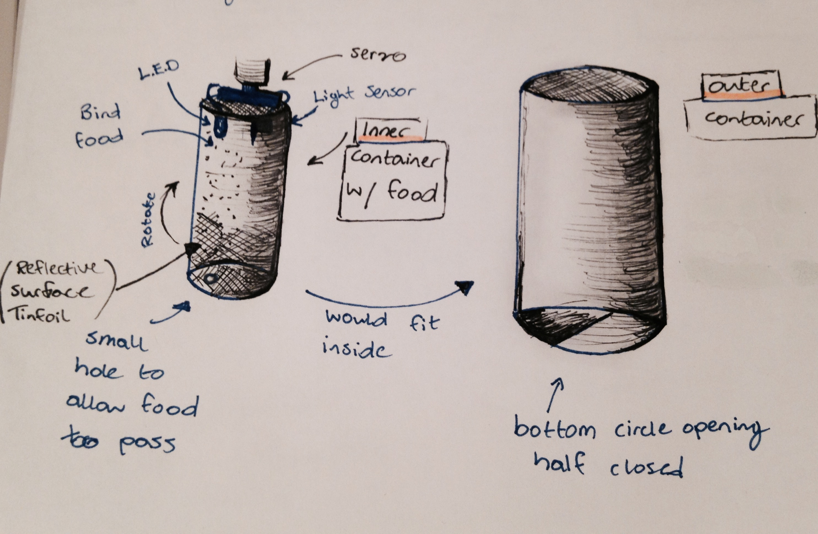
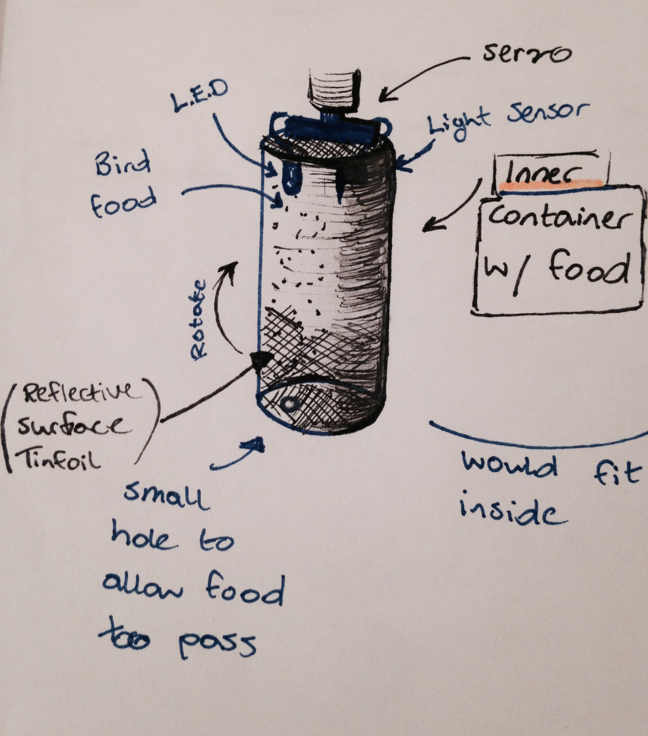
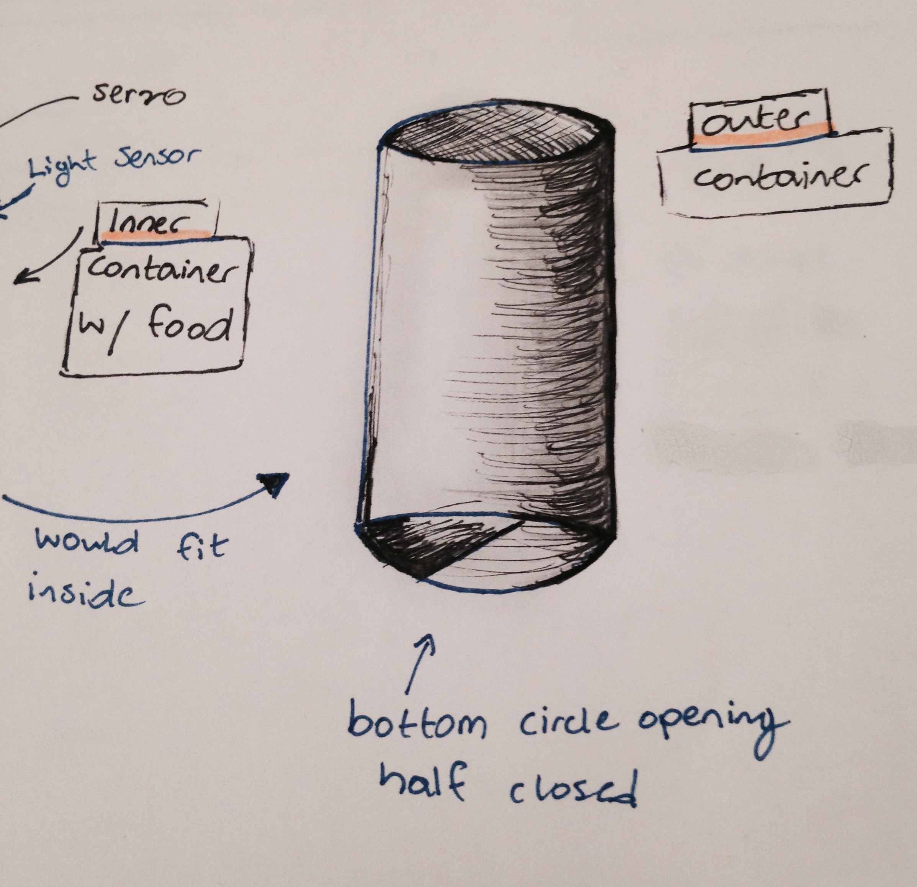
Design Idea
Short Recap on the FINO design.

Slide 5
How Fino was made
Brief outline of tools used/Equipment.

Slide 6
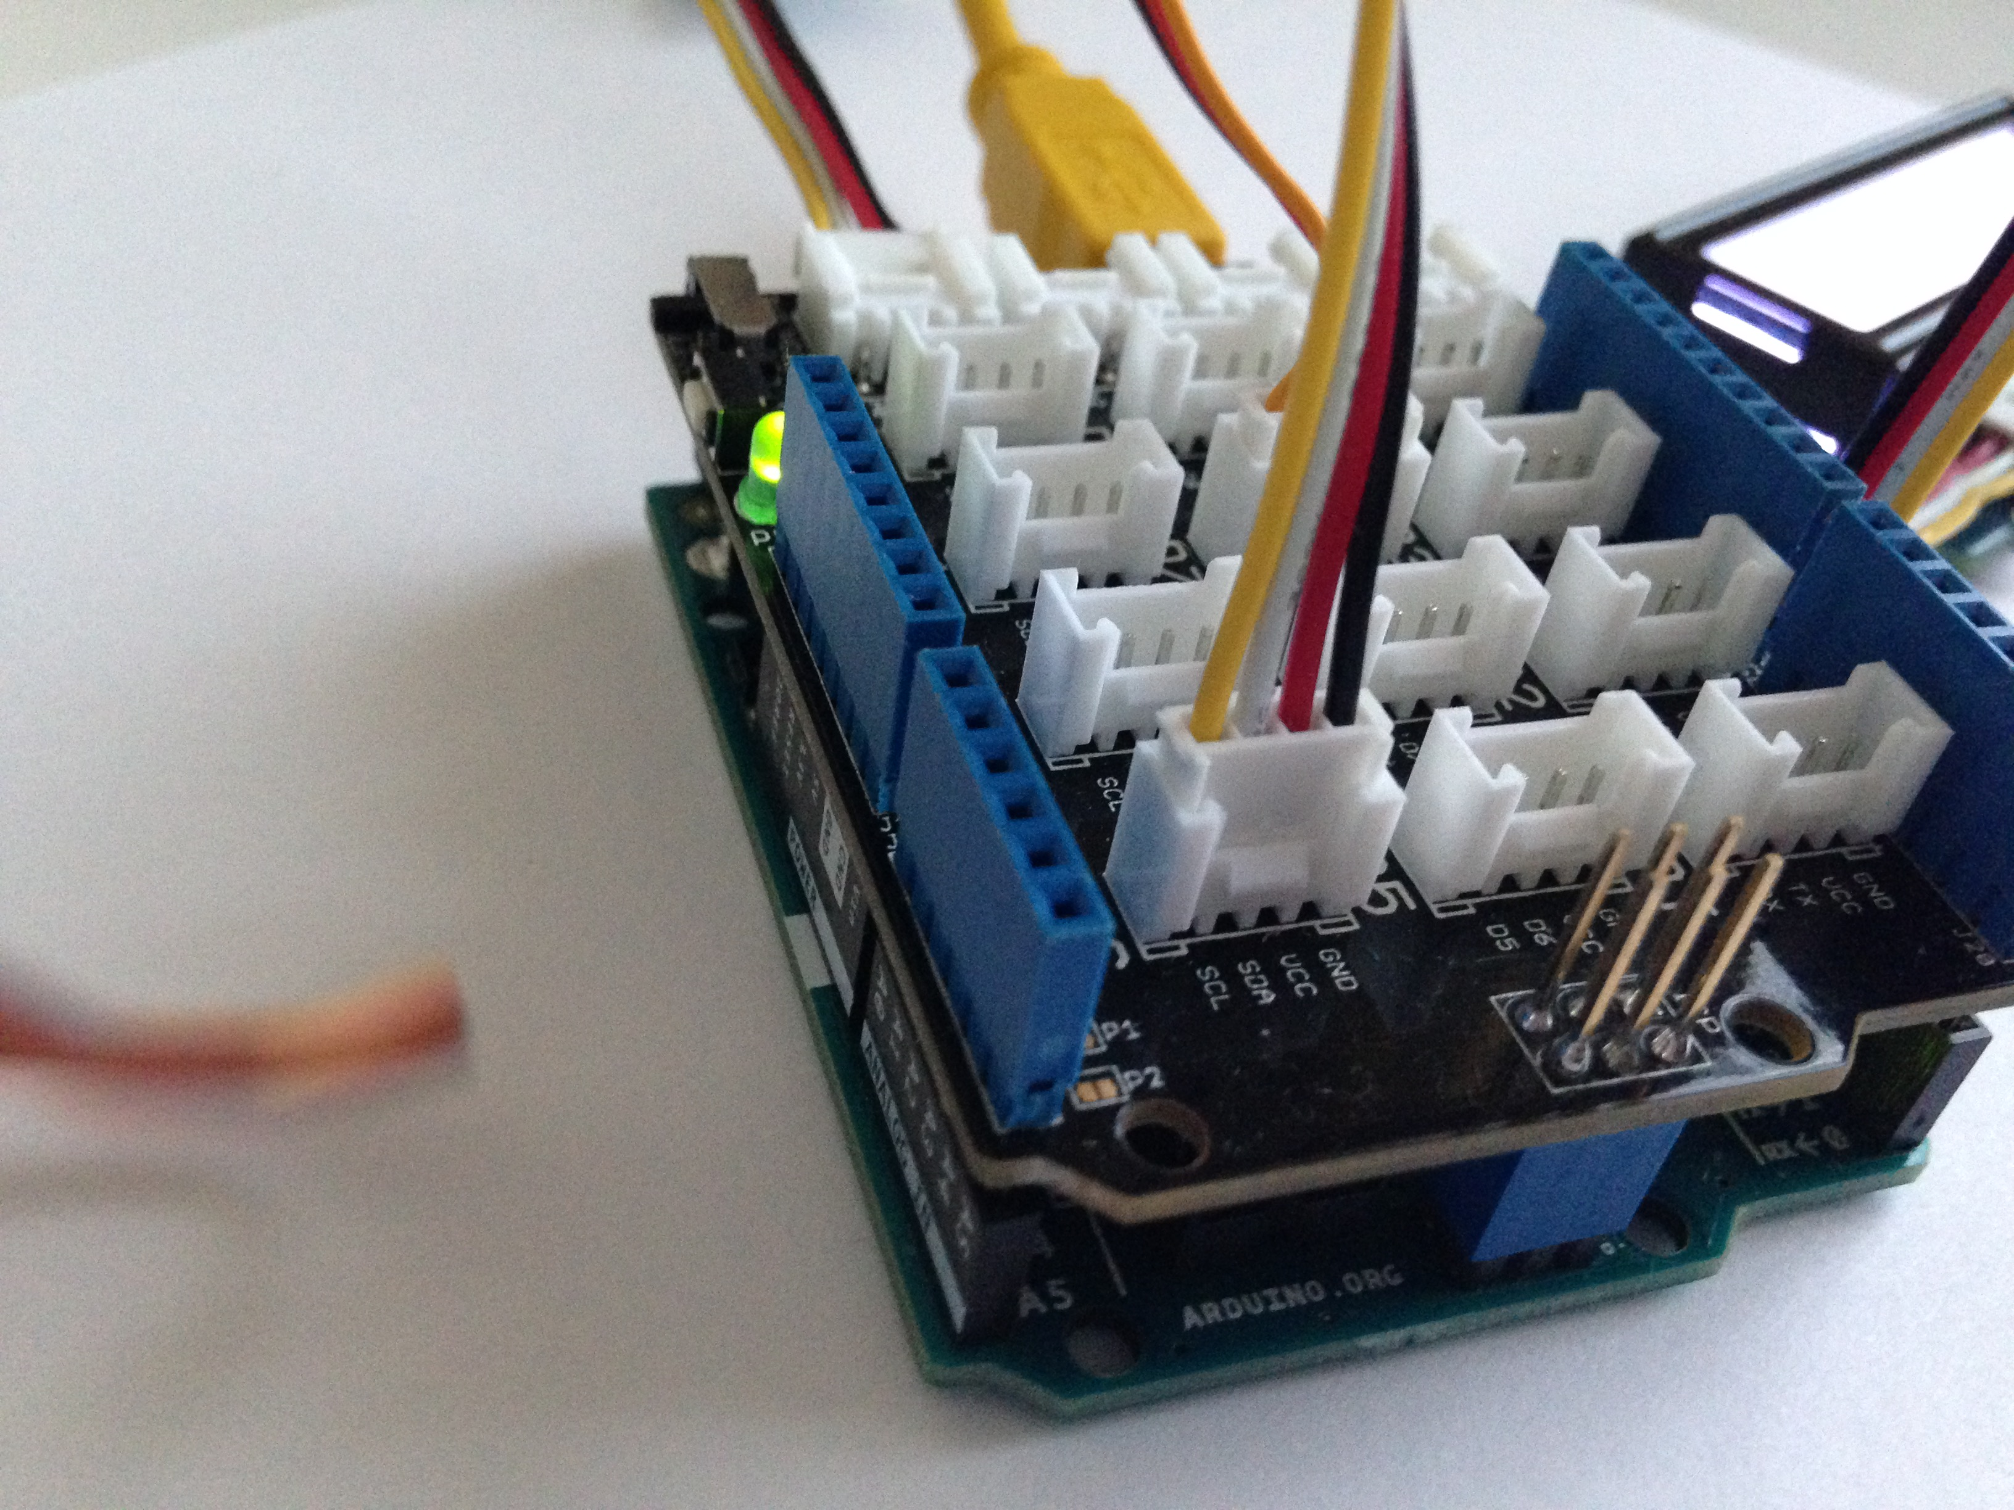
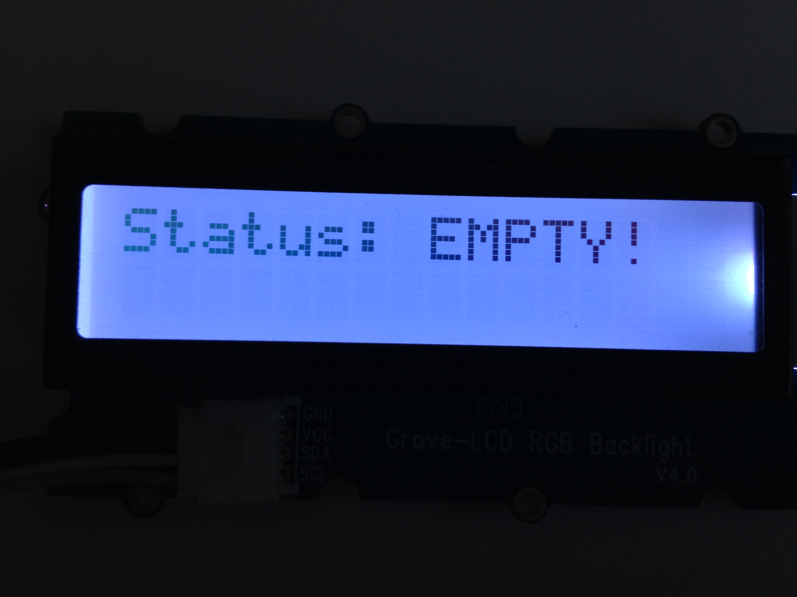
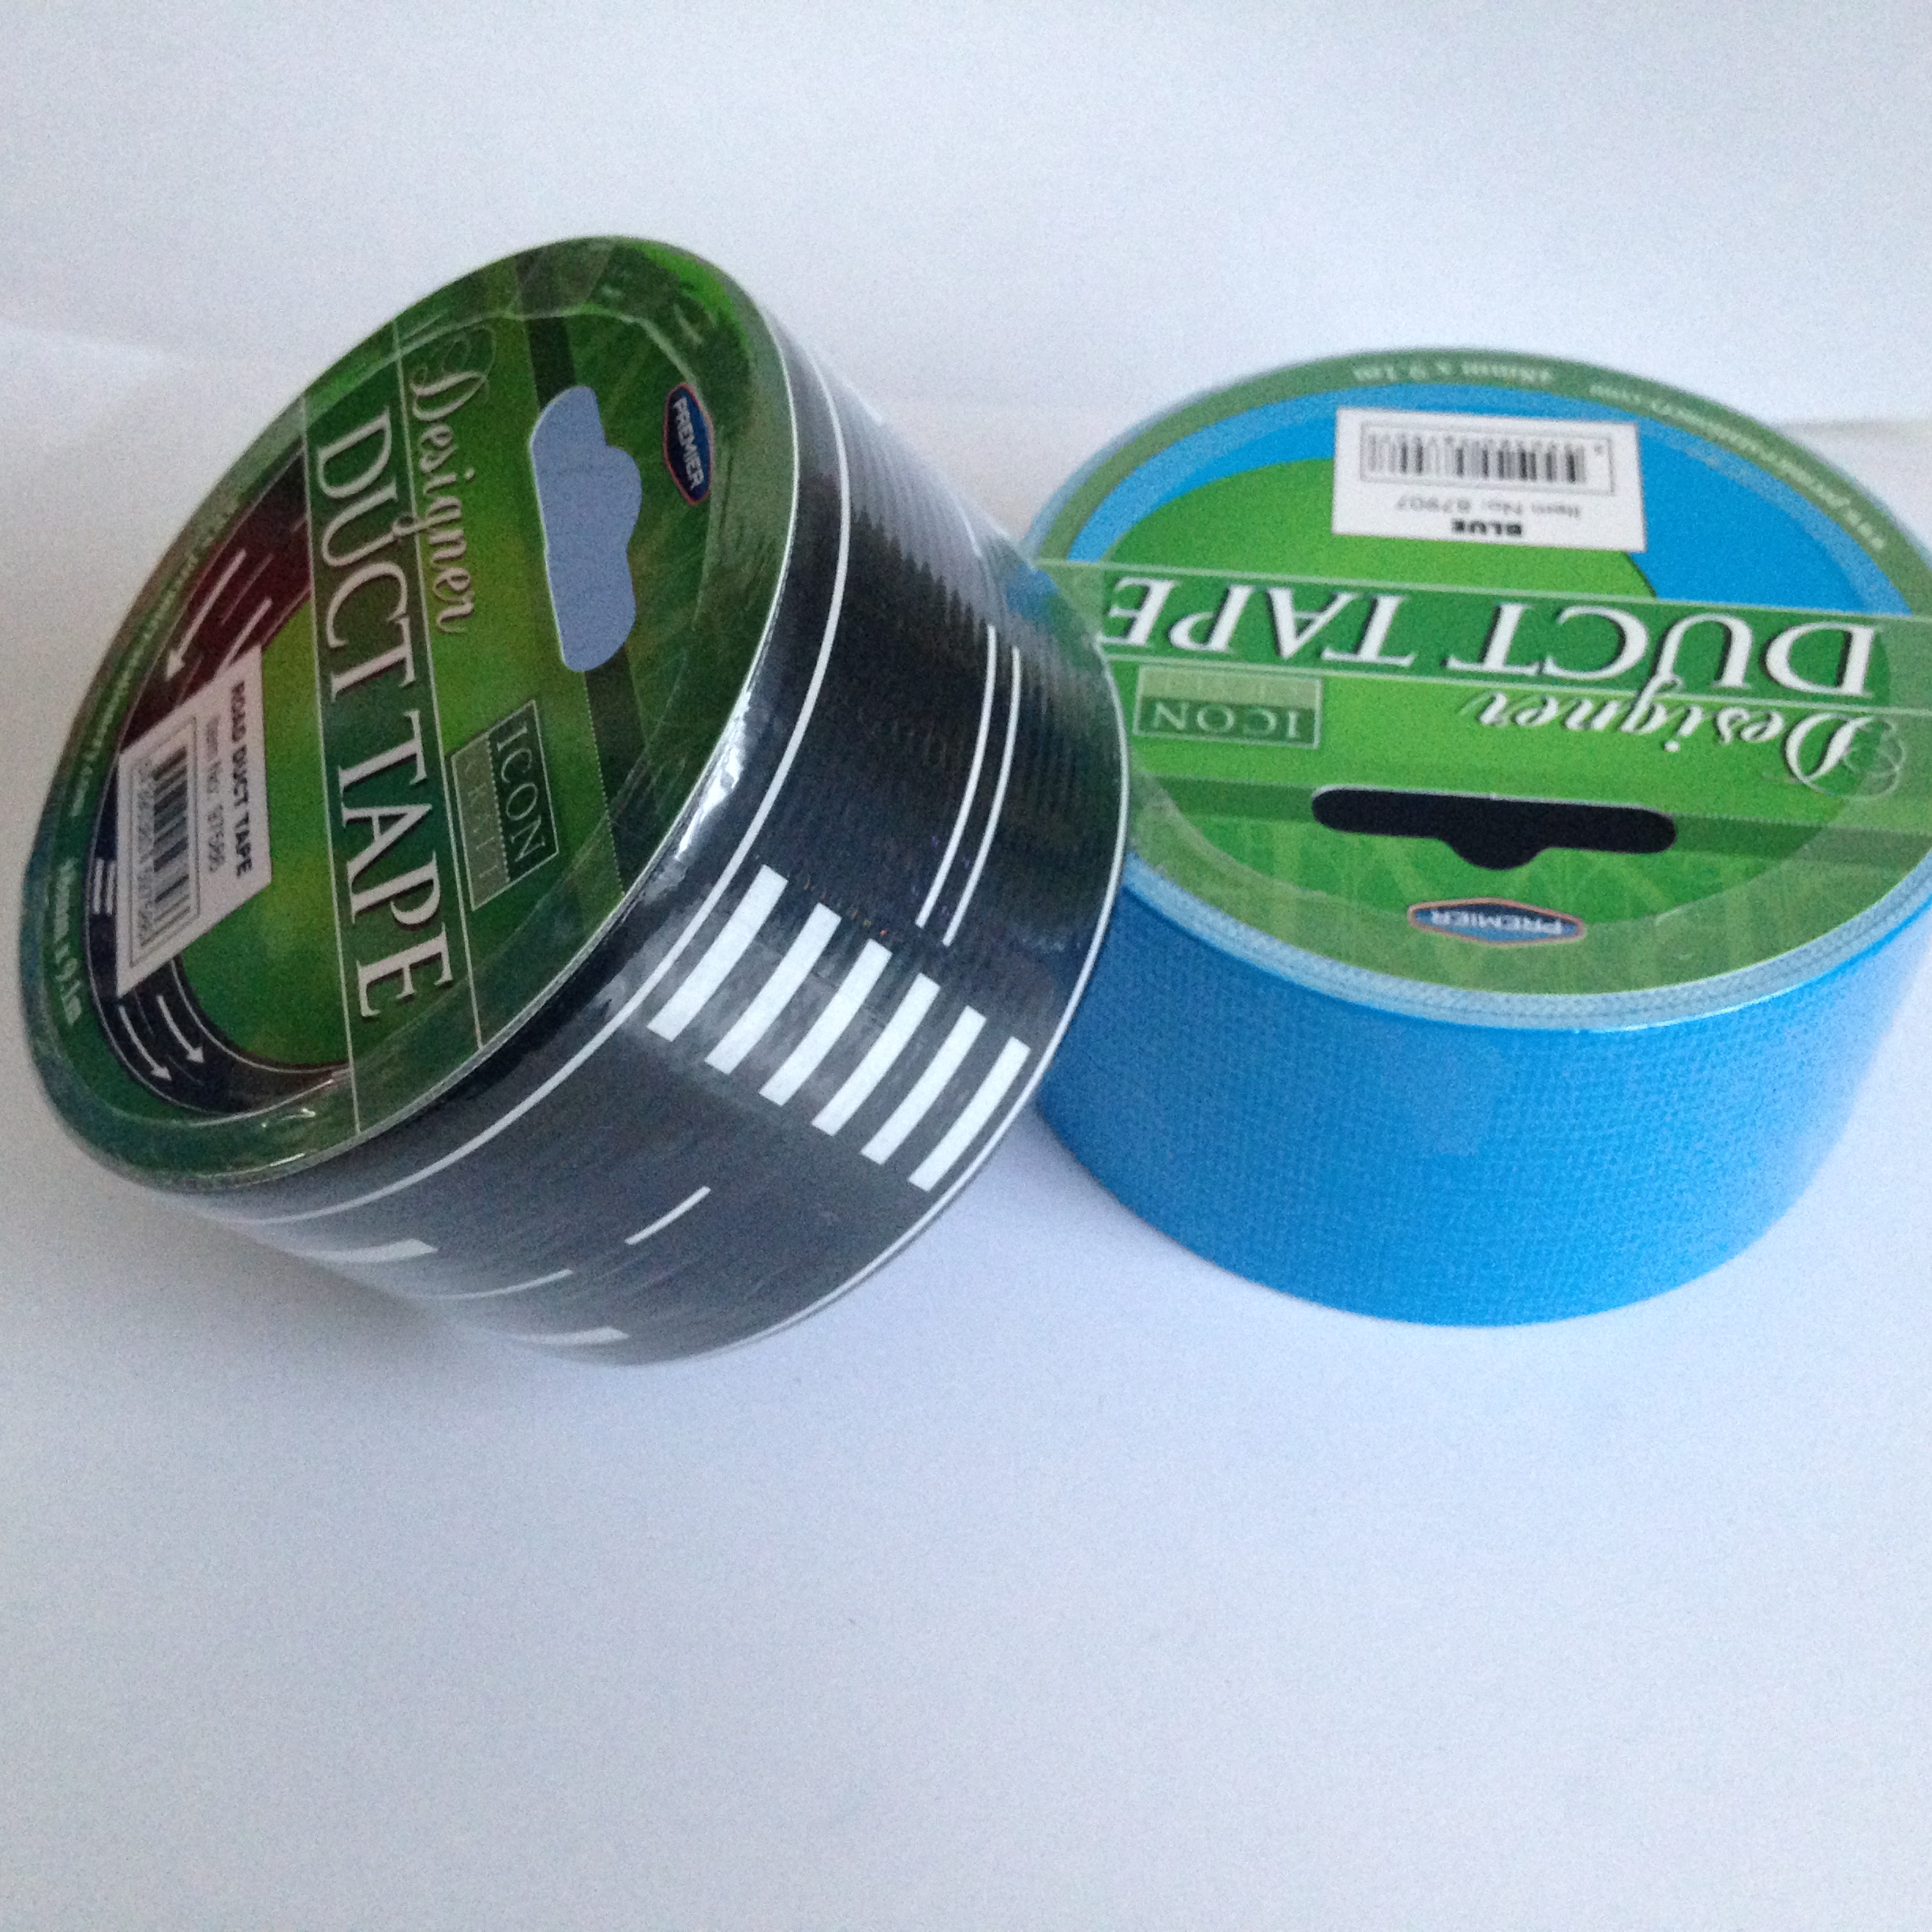
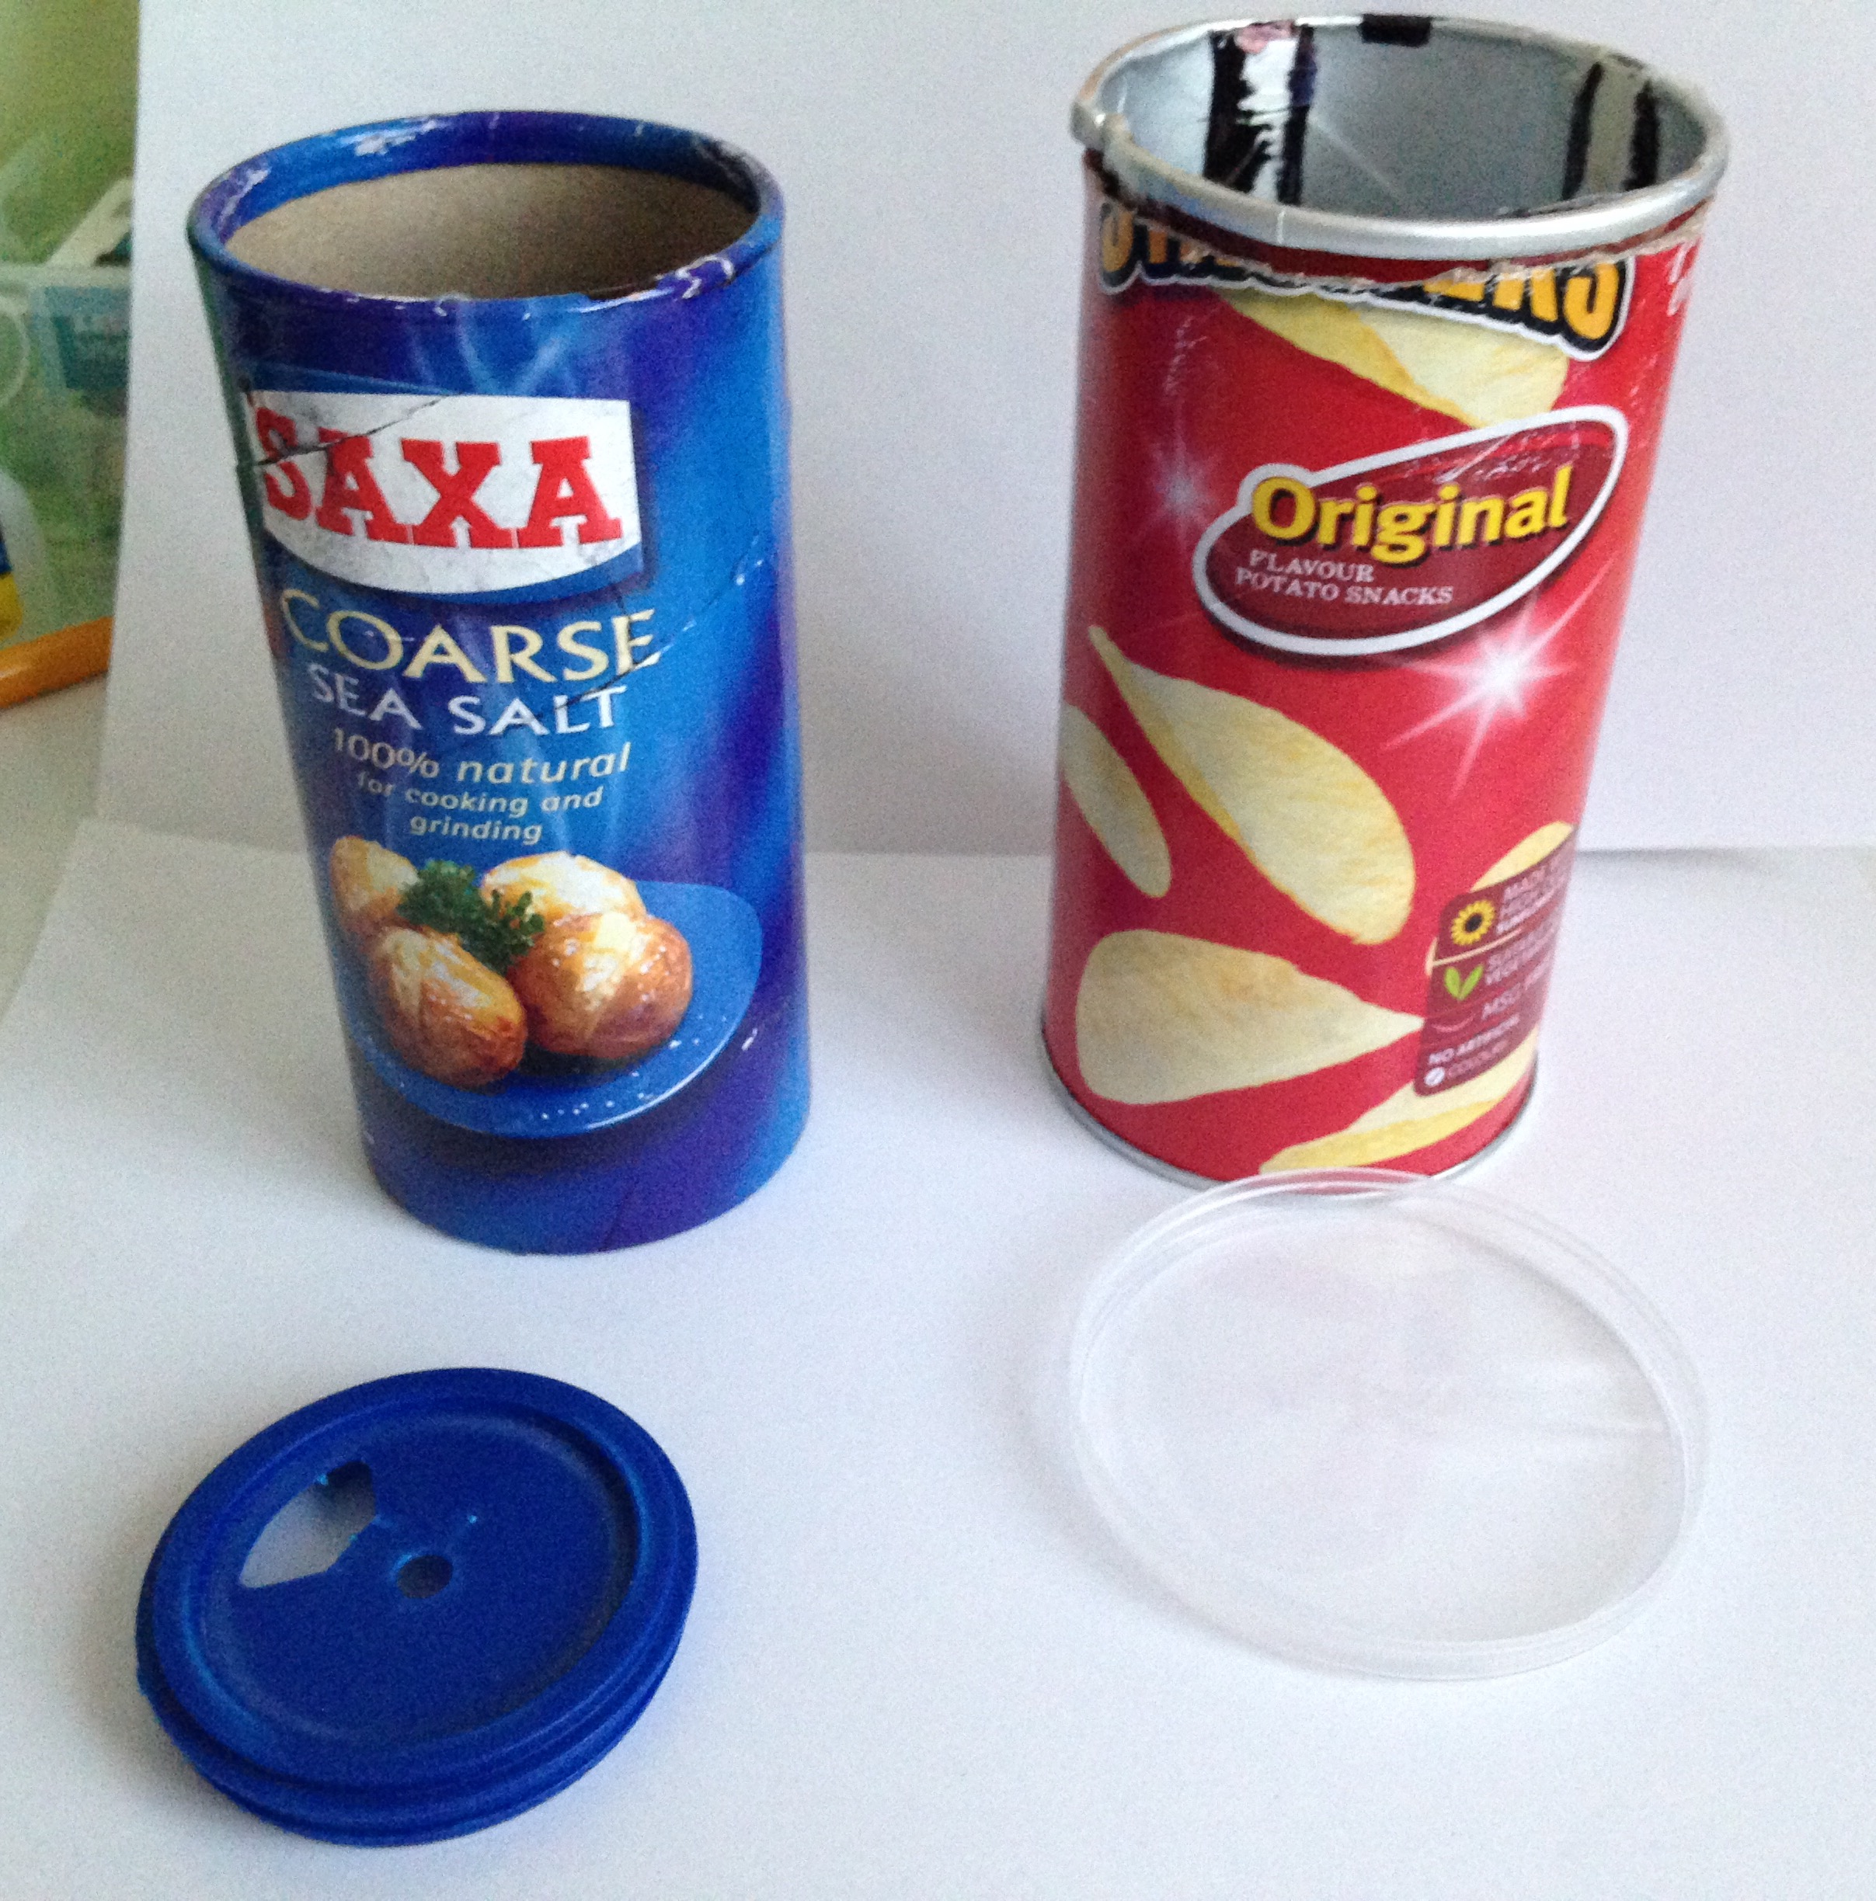
Birth of FINO
“He’s a good lad…”
Circuit Set/Code Tested.
Gathering & Setting up of materials.
A lot of DIY.
Tape, tape, tape…
More tape…
Hooking up Light Sensor.
Bird food everywhere.

Slide 7
Code
Brief explanation of how the code works.

Slide 8
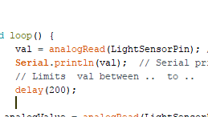
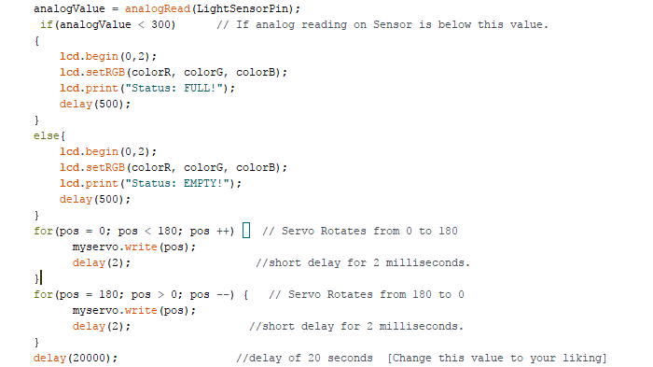
Code
“There she goes…”
Code Explained in detail: ‘https://github.com/loti-ibrahimi/Project-FINO/blob/master/Fino.ino’

Slide 9
Finale
FINO preview.

Slide 10
Any questions?
Check out full FINO preview ~ GitHub Website:
https://loti-ibrahimi.github.io/Project-FINO/

